Slide 1
transitivity and clustering coefficients

Slide 2
Modeling Real World Networks with Graphs
A network structure is modeled as a graph or directed graph, often with labels assigned to nodes or edges. Such a graph is expected to mimic the properties of the network: connectivity, distances between nodes, degree distributions, etc.
Questions about underlying graphs
Do they have any common properties? If so, what are those properties?
How arbitrary can they be? Does any graph can be the underlying graph of a real-world network?

Slide 3
Random Graphs

Slide 4
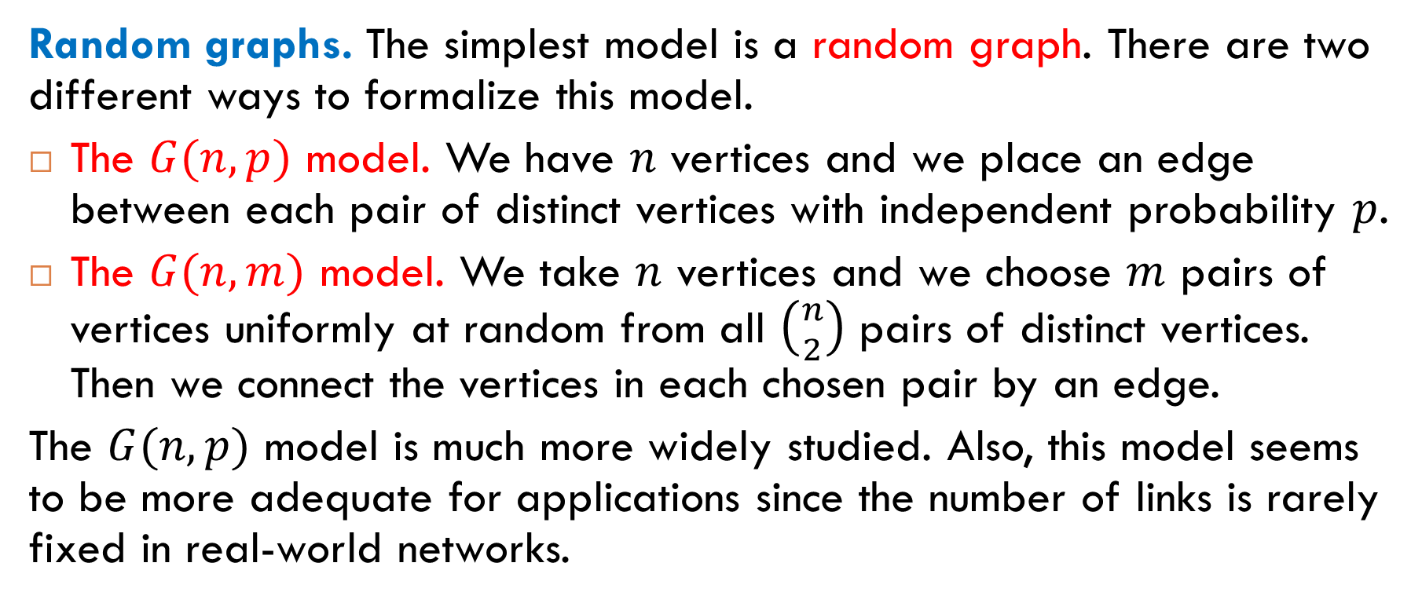
Two Random Graph Models
Random graphs. The simplest model is a random graph. There are two different ways to formalize this model.
The $G(n,p)$ model. We have $n$ vertices and we place an edge between each pair of distinct vertices with independent probability $p$.
The $G(n,m)$ model. We take $n$ vertices and we choose $m$ pairs of vertices uniformly at random from all $\left({n \atop 2}\right)$ pairs of distinct vertices. Then we connect the vertices in each chosen pair by an edge.
The $G(n,p)$ model is much more widely studied. Also, this model seems to be more adequate for applications since the number of links is rarely fixed in real-world networks.

Slide 5
Example
Two realizations of a random graph with $n = 12$ and $p =1/6$.

Slide 6
Another Example
Three realizations of a random graph with $n = 100$ and $p =0.03$.

Slide 7
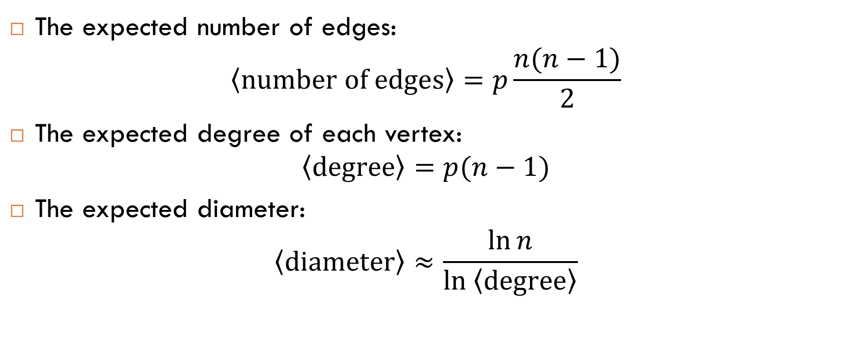
Some Expectations for Random Graphs
The expected number of edges:
$$\left\langle \text{number} \text{of} \text{edges}\right\rangle =p\frac{n(n−1)}{2}$$
The expected degree of each vertex:
$$\left\langle \text{degree}\right\rangle =p(n−1)$$
The expected diameter:
$$\left\langle \text{diameter}\right\rangle ≈\frac{\ln{n}}{\ln\left\langle \text{degree}\right\rangle }$$

Slide 8
Are Real-World Networks Random?
Question
Are random graphs good models of real-world networks?
Answer
No. We will see many big differences between random graphs and graphs underlying real-world networks.
For example:
transitivity;
average distance between nodes;
degree distribution.
we will discuss it now
we will discuss them later

Slide 9
Will be continued on Wednesday.

Slide 10

Reading
Section 7.3

